Slide 1

NorthWind Analysis
Capstone Project 1
Group G
Data Analytics Cohort 5

Slide 2
Team Members
01
02
03
Shafqat Ali
Daniyal Ahmed
University of Punjab
Space Science
Matric
Asif Javed
IE & M
DUET

Slide 3
Contents
Introduction To Database
Project Background
ERD (Schema)
Bussiness Problems
Inshigts and Visulizations
Recomendation
Group G
Data Analytics | Cohort 5 | IEC

Slide 4
Awesome words

Slide 5
—Geofferry Moore
“Without big data analytics companies are blind and deaf wandering out onto the web like deer on a freeway.”

Slide 6
01
Intoduction

Slide 7
Introduction to Database
Northwind is a sample database used to demonstrate the functionality of Microsoft Access and SQL Server. It was created to simulate a fictional company that sells specialty food products. The database contains information on customers, orders, employees, products, and suppliers.

Slide 8
02
Project Background

Slide 9
Project Background
The Northwind database is a well-known and widely used sample database in the field of data analytics. It provides a rich set of data, including information on customers, orders, employees, products, and suppliers, that can be used to demonstrate various data analysis techniques and methodologies. This database is especially useful for learning and practicing data analytics, as it includes real-world scenarios, such as managing inventory, processing orders, and generating reports. In this project, we will use the Northwind database to perform a comprehensive data analysis, including data cleaning, exploration, and visualization. By leveraging the insights obtained from this analysis, we aim to uncover patterns and relationships in the data and make informed business decisions based on the findings.

Slide 10
03
ERD (Schema)

Slide 11

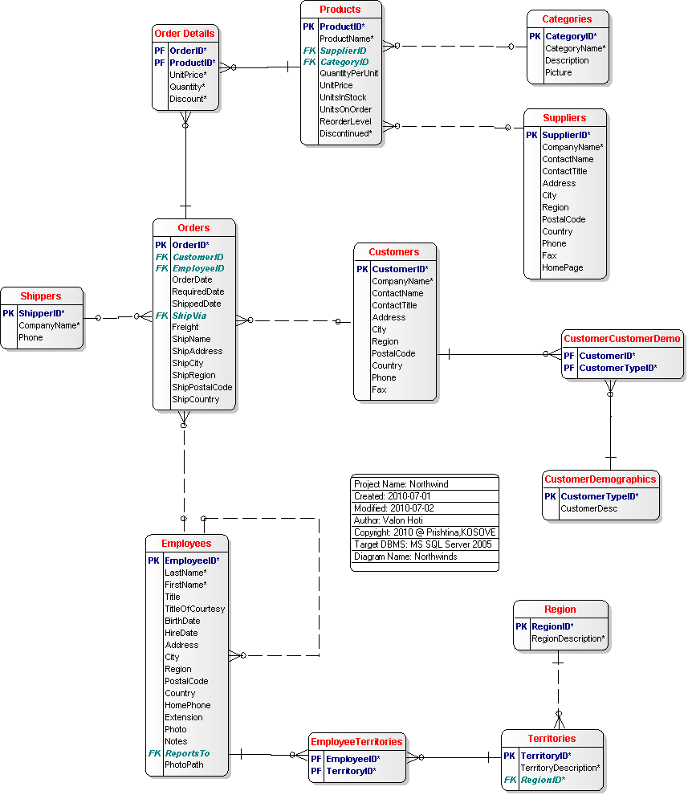
A picture is worth a thousand words

Slide 12
ERD Diagram Tables
Shippers
Order details
Orders
Employees
Products
Customers
Categories
Suppliers
Reigon

Slide 13
04
Bussiness Problems

Slide 14
Questions of business Problems
1 | Create a reoprt for sales by year?
2 | Create a reoprt for sales by category?
3 | Create a reoprt for employee salary?
4 | Create a reoprt for sales for 1997?
5 | Create a reoprt for Category sales for 1997?
6 | Create a reoprt for the quarterly orders?
7 | Create a reoprt for stock in unit by country and category?
8 | Create a report for Customers with early highest sales?

Slide 15
05
Why we choose this Database

Slide 16
Why we choose this database
Tables
Mercury is the closest planet to the SunIt contain bunch of tables, so it was a good entity relationship.
Design
Data is very well designed to find insights
We get to know the whole idea, what is the need, who are the stakeholder, and what we can get out of it.
Stakeholders and Idea

Slide 17
06
Insights and Visulizations

Slide 18
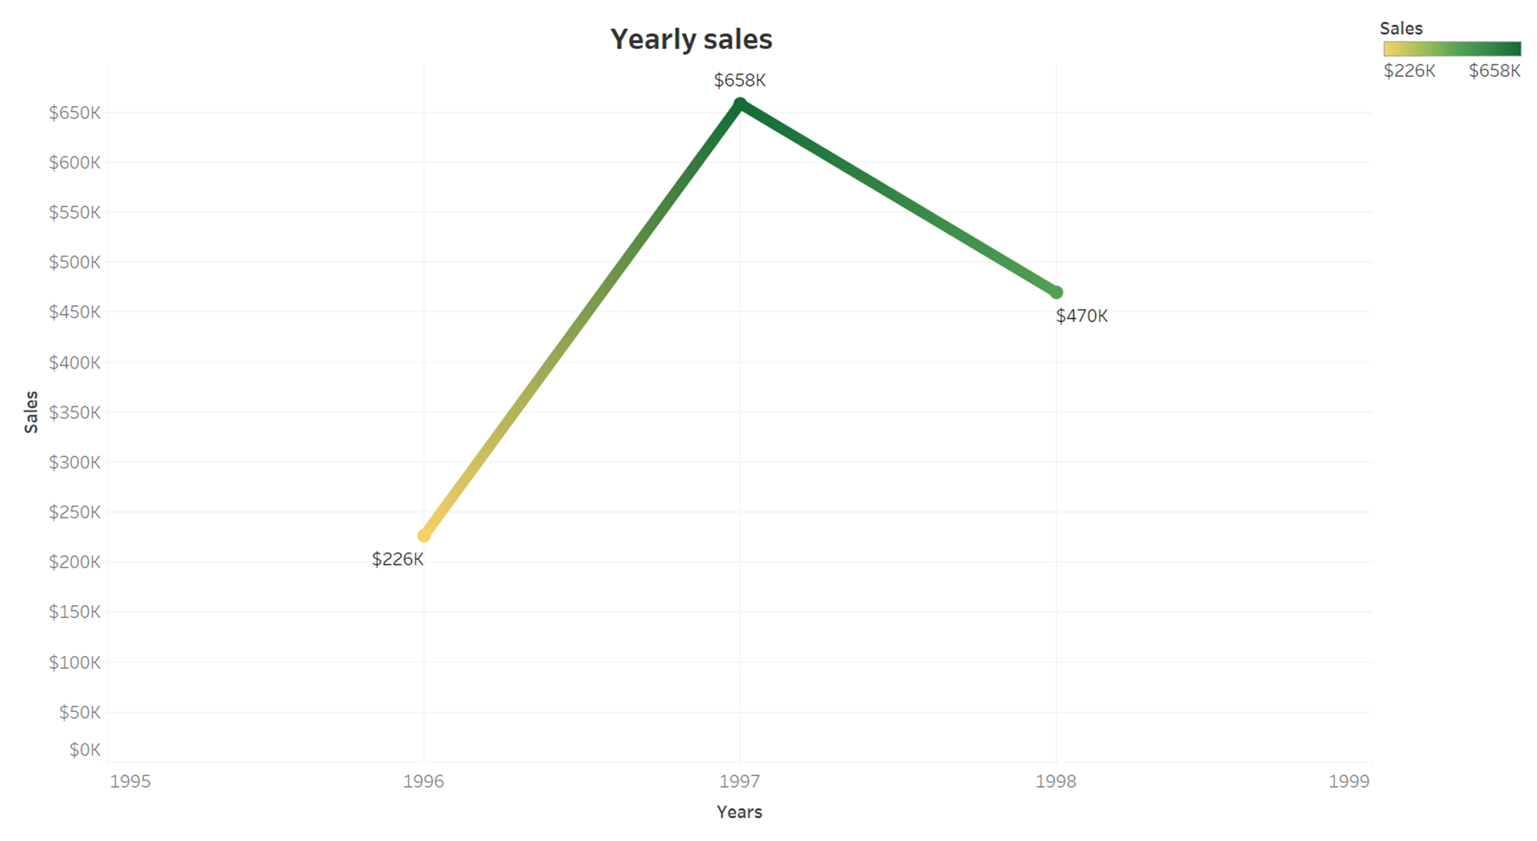
VISULIZATIONS

Slide 19
$658,000
Big numbers catch your audience’s attention

Slide 20
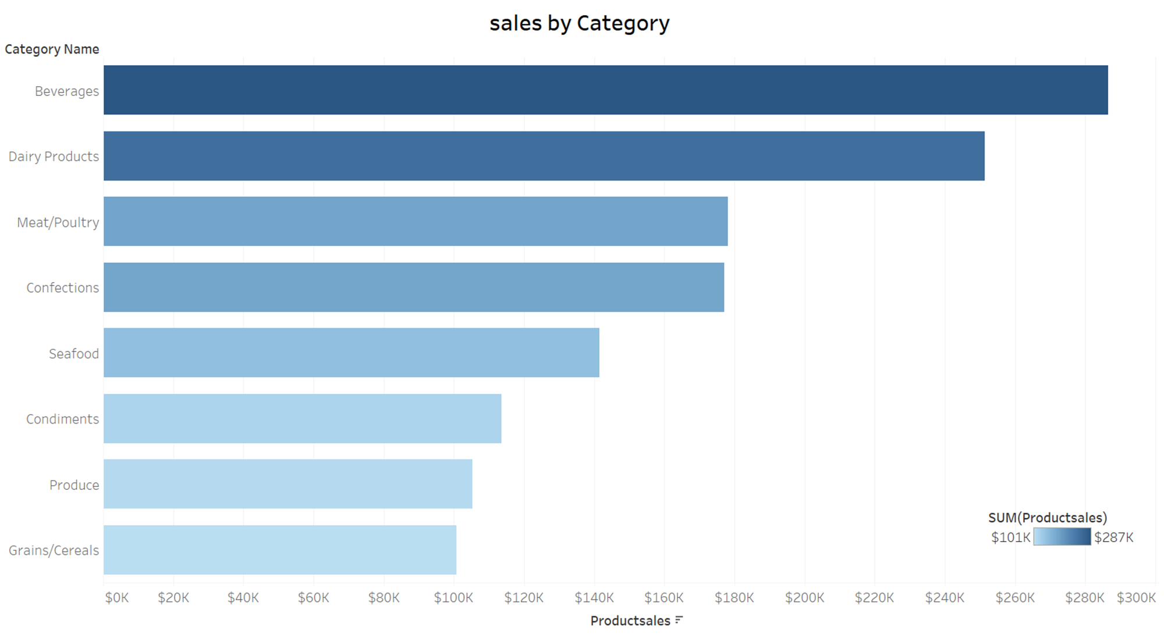
VISULIZATIONS

Slide 21
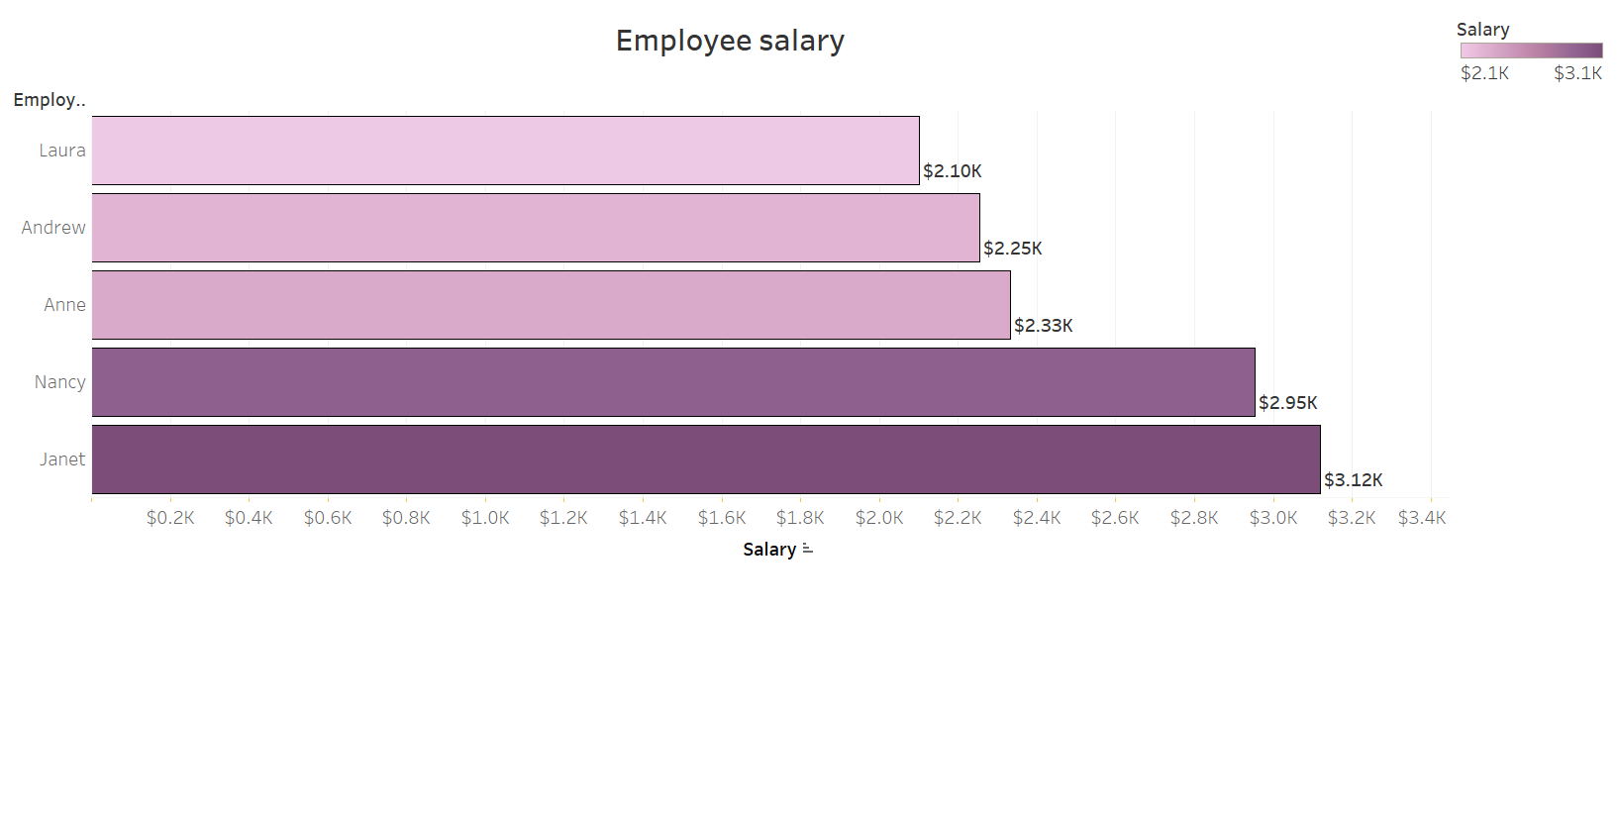
INSIGHTS

Slide 22
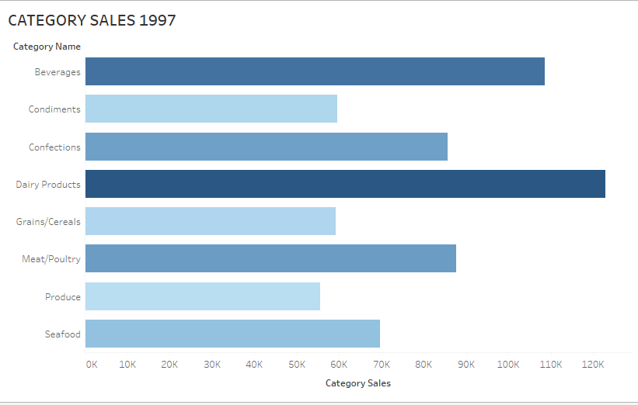
INSIGHTS

Slide 23
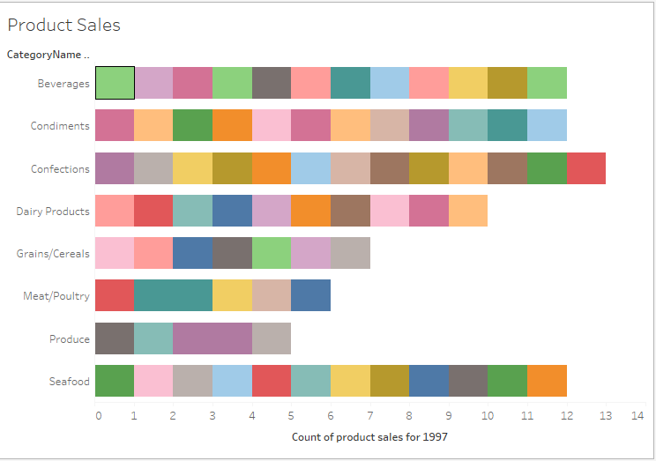
INSIGHTS

Slide 24
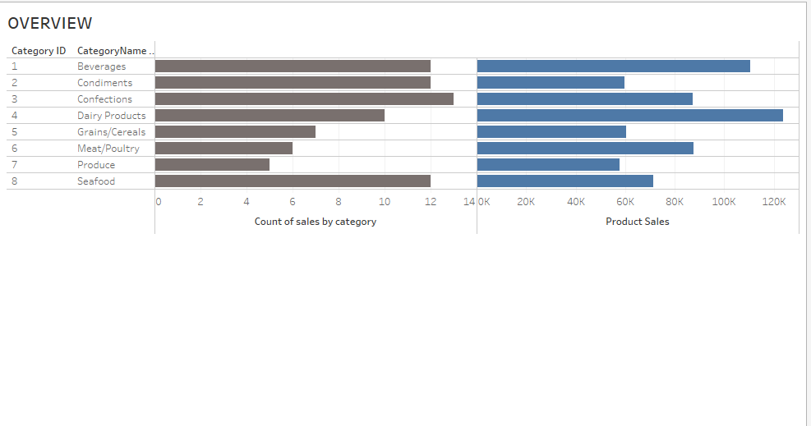
INSIGHTS

Slide 25
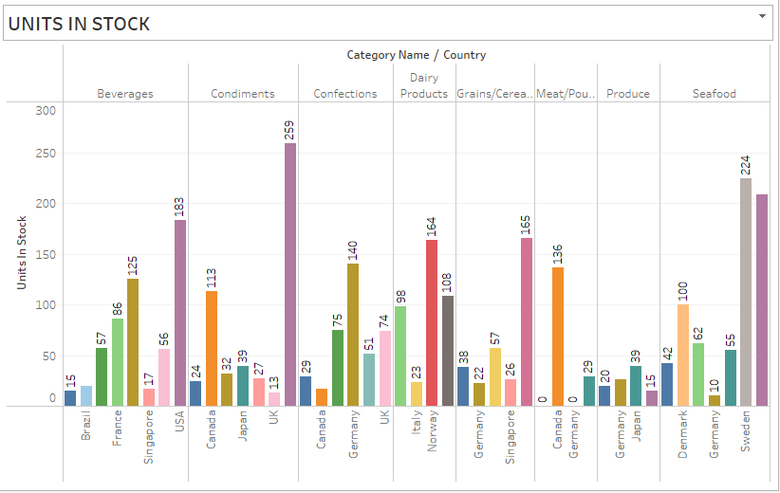
INSIGHTS

Slide 26
Time approach and Distribution
Quarter 1
Quarter 2
Quarter 3
Quarter 4
January to March
July to September
April to June
October to December

Slide 27
Thanks!
Any questions?

